Slide 1
Finance Receipting using Robotic Process Automation
PIP2001 Capstone Project
Review-1
Batch Number: CSD G-36
Under the Supervision of,
Dr. Chandrashekar Vadivelraju
Professor
School of Computer Science and Engineering
Presidency University
STUDENT ROLL NO | STUDENT NAME
20211CSD0132 | KEREN ELISHEBA S
20211CSD0179 | VIKHYATH M B
20211CSD0168 | CHIRAG K SRINIVAS
Name of the Program: B.Tech Computer Science and Engineering(Data Science)
Name of the HoD: Prof. Saira Banu
Name of the Program Project Coordinator: Dr Manjula H M
Name of the School Project Coordinators: Dr. Sampath A K / Dr. Abdul Khadar A / Mr. Md Ziaur Rahman

Slide 2
Introduction
Robotic Process Automation (RPA) is transforming finance receipting by streamlining and automating repetitive, rule-based tasks, leading to enhanced operational efficiency and reduced manual effort. In finance receipting, RPA automates the process of capturing, validating, and reconciling payment receipts, ensuring greater accuracy and speed in data entry, invoice processing, and payment tracking. This technology eliminates human errors, accelerates transaction cycles, and improves cash flow management. By integrating RPA into receipting, organizations can achieve higher productivity, reduce operational costs, and ensure compliance with financial regulations. The adoption of RPA enhances decision-making through real-time data availability, allowing finance teams to focus on more strategic activities. This paper explores the benefits, challenges, and best practices of implementing RPA in finance receipting processes, highlighting its potential to revolutionize financial operations

Slide 3
Literature Review
METHODS OVERVIEW
1. Current state, trends, and implementation of Robotic Process Automation (RPA)
Advantages: Offers cost reduction, improved efficiency, non-invasive system integration
Limitations: Challenges with unstructured data handling, interface dependencies, high setup costs
2. Implementation and effectiveness of digital receipts in online transactions
Advantages: Faster financial report preparation, and provides better transaction tracking
Limitations: Challenges with standardization across different platforms, security concerns, data storage requirements.
3. Adoption patterns, factors, and implementation strategies of Robotic Process Automation (RPA) across organizations and industries.
Advantages: Operational efficiency, cost reduction, improved accuracy
Limitations: Challenges in RPA adoption including high initial costs, resistance to change, limited capability for complex tasks, technical integration issues

Slide 4
Literature Review
4. Robotic Process Automation (RPA) in shaping the future digital workforce
Advantages: Workforce productivity by automating repetitive tasks, reducing operational costs, improving accuracy, enabling 24/7 operations
Limitations: Requires significant investment in training and infrastructure, and faces technical limitations in handling complex, judgment-based tasks and unstructured data.
5. Implementation and impact of Robotic Process Automation (RPA) specifically in accounting and auditing processes
Advantages: Speeds up financial processing, reduces human errors, improves compliance, ensures consistent reporting
Limitations: Challenges with complex financial decision-making, requires substantial initial investment, needs continuous updates for changing regulation
6. Transformative role of Robotic Process Automation (RPA) in modern accounting practices
Advantages: Automating routine tasks, improving data accuracy, reducing processing time, enabling real-time reporting
Limitations: Resistance to change from traditional practices, Complexity in handling non-standardized accounting processes

Slide 5
Existing method Drawback
ADVANTAGES
Manual Processing
Ease of Implementation
Control over the Process
Ability to Handle Physical Documents
ERP Methods
Transactional Visibility
ERP System Familiarity

Slide 6
Existing method Drawback
DISADVANTAGES
Manual Processing
Limited Automation Flexibility
Control over the Process
Ability to Handle Physical Documents
ERP Methods
Transactional Visibility
ERP System Familiarity

Slide 7
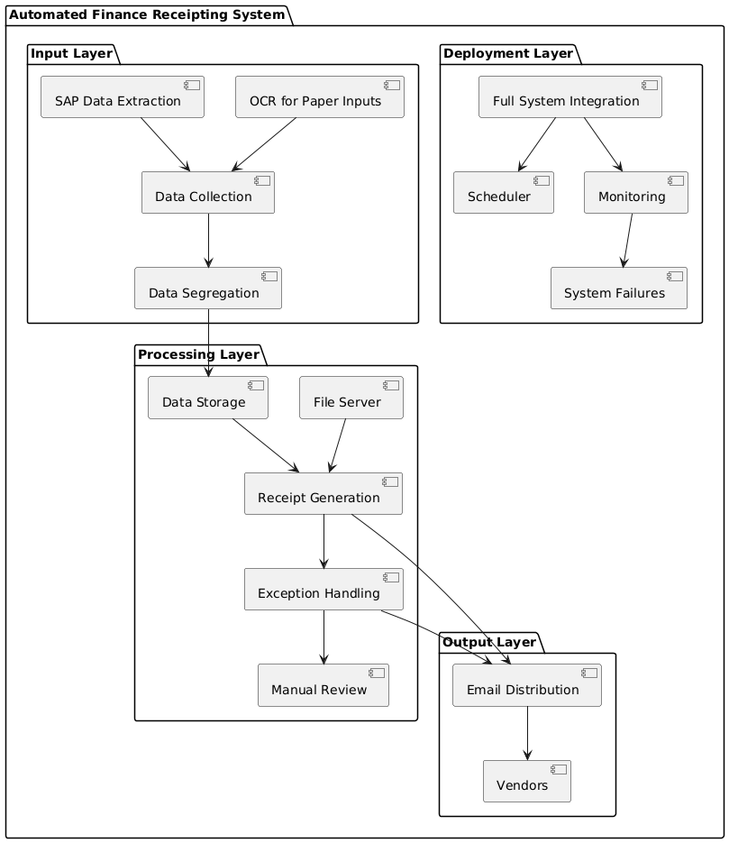
Proposed Method

Slide 8
Objectives
To design and implement a Robotic Process Automation (RPA) solution that automates the finance receipting process, handling 25,000 receipts per month efficiently and accurately.
Design a solution to integrate paper-based receipts into the automated workflow, possibly using Optical Character Recognition (OCR) technology.
Maintain high accuracy in data processing and receipt generation, ensuring compliance with financial regulations and company policies.
Create an automated email system to send generated receipts to the corresponding vendors as specified in the source file.
Implement a system to dynamically generate receipts using appropriate templates based on transaction type, sourcing templates from the File Server.

Slide 9
Methodology/Modules
Module 1: SAP Integration
Module 2: Data Segregation and Rules Engine
Module 3: Document Generation Module
Module 4: Email Automation
Module 5: OCR and Exception Handling

Slide 10
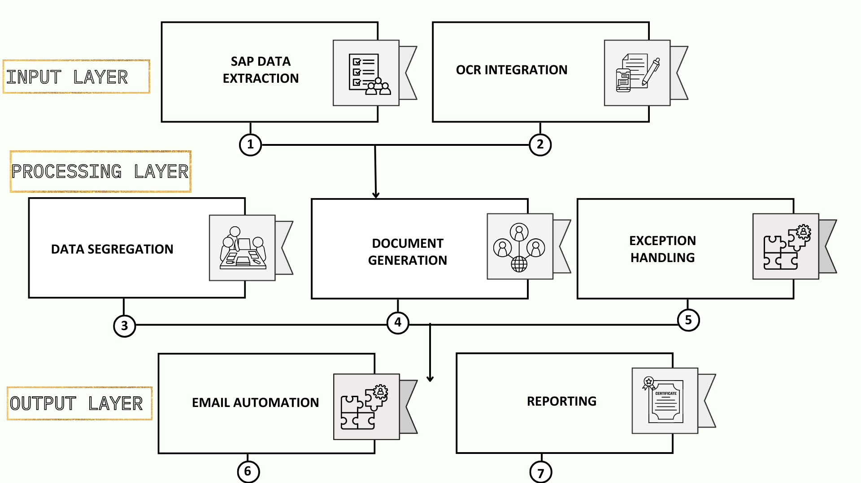
Architecture

Slide 11
Hardware/software components
Software Details:
RPA Tools: UiPath, Automation Anywhere, Blue Prism (for RPA-based solutions).
Programming Tools: Python, JavaScript (for custom scripting).
IDE: Visual Studio Code, PyCharm (for development).
Database: SQLite, (for data storage).
Email Automation: Gmail/Outlook SMTP (for email sending).
Document Generation: Python-docx, Microsoft Word (for receipts/reports).
Web Automation: Selenium, Puppeteer (for web-based automation).
Cloud Platforms: Heroku, AWS Lambda (for deployment in the cloud).
Version Control: GitHub,

Slide 12
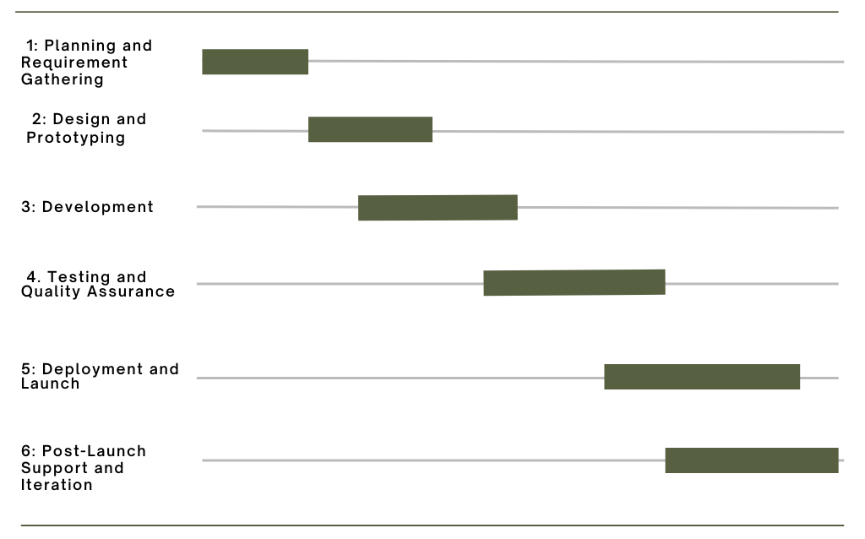
Timeline of Project

Slide 13
Expected Outcomes
Increased Efficiency and Reduced Manual Work
Reduced Errors and Improved Accuracy
Faster Processing Time
Cost Savings
Scalability

Slide 14
Conclusion
In this project, we have designed and will implement an automated Finance Receipting solution using Robotic Process Automation (RPA) to streamline and optimize back-office operations. The automation solution is capable of handling a high volume of 25,000 receipts per month, with minimal manual intervention, while addressing the challenges posed by structured and paper-based data inputs. By leveraging RPA to automate tasks such as data extraction, segregation, receipt generation, and email distribution, we have successfully enhanced operational efficiency, accuracy, and scalability.
The proposed solution will effectively reduce human errors, improve the speed of processing, and ensured compliance with business rules, while also providing an exception handling mechanism to address outliers (10% of cases). This project demonstrated the significant impact of automation on reducing repetitive manual tasks, improving cost-efficiency, and enhancing overall productivity. The inclusion of a real-time reporting and monitoring dashboard provided transparency, enabling better decision-making and process optimization.
In conclusion, the automated finance receipting system presents a scalable, robust, and efficient approach to managing high-volume financial transactions, which can be easily adapted to other industries with similar repetitive tasks. The solution not only addresses current business needs but also sets the stage for future advancements in automation and process optimization, offering considerable long-term benefits for organizations.

Slide 15
Github Link
https://github.com/keren05/CAPSTONE-PROJECT-G36

Slide 16
References
J. G. Enríquez, A. Jiménez-Ramírez, F. J. Domínguez-Mayo and J. A. García-García, "Robotic Process Automation: A Scientific and Industrial Systematic Mapping Study“, in IEEE Access, vol. 8, pp. 39113-39129, 2020, doi: 10.1109/ACCESS.2020.2974934.
Kosadi, Ferry & Ginting, Wajib & Merliana, Vina. (2021). Digital Receipts of Online Transactions in the Reconciliation Process and the Preparation of Financial Reports. Journal of Indonesian Economy and Business. 36. 31. 10.22146/jieb.59884.
Costa, Diogo & S. Mamede, Henrique & Mira da Silva, Miguel. (2022). Robotic Process Automation (RPA) Adoption: A Systematic Literature Review. Engineering Management in Production and Services. 14. 1-12. 10.2478/emj-2022-0012.
Madakam, S., Holmukhe, R. M., & Jaiswal, D. K.. (2019). The Future Digital Work Force: Robotic Process Automation (RPA). JISTEM - Journal of Information Systems and Technology Management, 16, e201916001. https://doi.org/10.4301/S1807-1775201916001

Slide 17
References
Balamurugan, A & Vamsi, M & Bhattacharya, Rajib & Mohammed, Shariq & Kaushik, Priyanka & Haralayya, Dr. (2023). ROBOTIC PROCESS AUTOMATION (RPA) IN ACCOUNTING AND AUDITING OF BUSINESS AND FINANCIAL INFORMATION. Manager. 58. 127-142.
Ayinla, Benjamin & Atadoga, Akoh & Ike, Chinedu & Ndubuisi, Ndubuisi & Asuzu, Onyeka Franca & Adeleye, Rhoda. (2024). THE ROLE OF ROBOTIC PROCESS AUTOMATION (RPA) IN MODERN ACCOUNTING: A REVIEW - INVESTIGATING HOW AUTOMATION TOOLS ARE TRANSFORMING TRADITIONAL ACCOUNTING PRACTICES. Engineering Science & Technology Journal. 5. 427-447. 10.51594/estj.v5i2.804.

Slide 18

Project work mapping with SDG

Slide 19
Thank You

